Slide 1
Wireshark Skilling
Key Document
10th August 2021

Slide 2
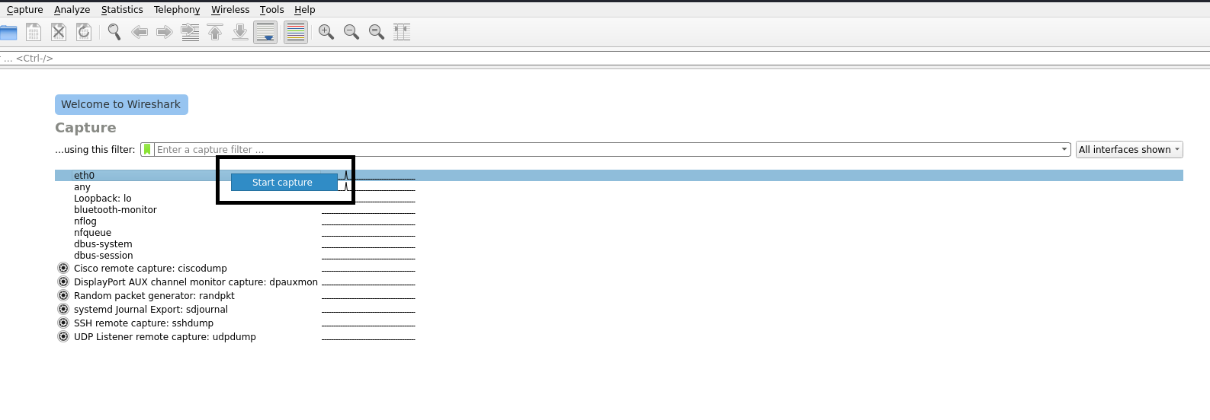
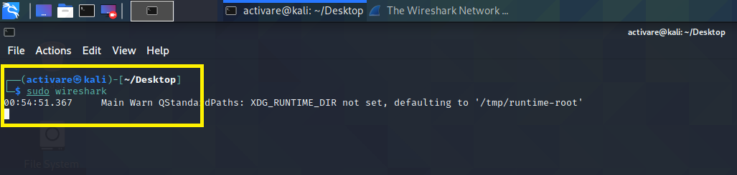
Pre – Class Task
1. What is the main purpose of Wireshark tool? How can we utilize the Wireshark tool and for what?
A. Wireshark is a packet sniffer and analysis tool. It captures network traffic on the local network and stores that data for offline analysis. Wireshark captures network traffic from Ethernet, Bluetooth, Wireless cards. Analyzing Data Packets on Wireshark.
2. How we can capture the data packets using the Wireshark tool? Mention the procedure.
A. Open terminal in Kali Linux, In Terminal type “sudo wireshark” then Wireshark will be opened.

Slide 3
3. Describe about the each and every column in the top pane in Wireshark tool.
A. No.: This is the number order of the packet that got captured. The bracket indicates that this packet is part of a conversation.
Time: This column shows you how long after you started the capture that this packet got captured. You can change this value in the Settings menu if you need something different displayed.
Source: This is the address of the system that sent the packet.
Destination: This is the address of the destination of that packet.
Protocol: This is the type of packet, for example, TCP, DNS, DHCPv6, or ARP.
Length: This column shows you the length of the packet in bytes.
Info: This column shows you more information about the packet contents, and will vary depending on what kind of packet it is.

Slide 4
In - Class Task

Slide 5
1. By default, the network card will only communicate with the network which is directed to your MAC Address. So, Using the Wireshark, capture the network which will be communicate with your MAC Address only but not the whole network from the Host or not even the network of other devices.
Procedure: 1. Open terminal in Kali Linux, In Terminal type “sudo wireshark” then Wireshark will be opened.

Slide 6
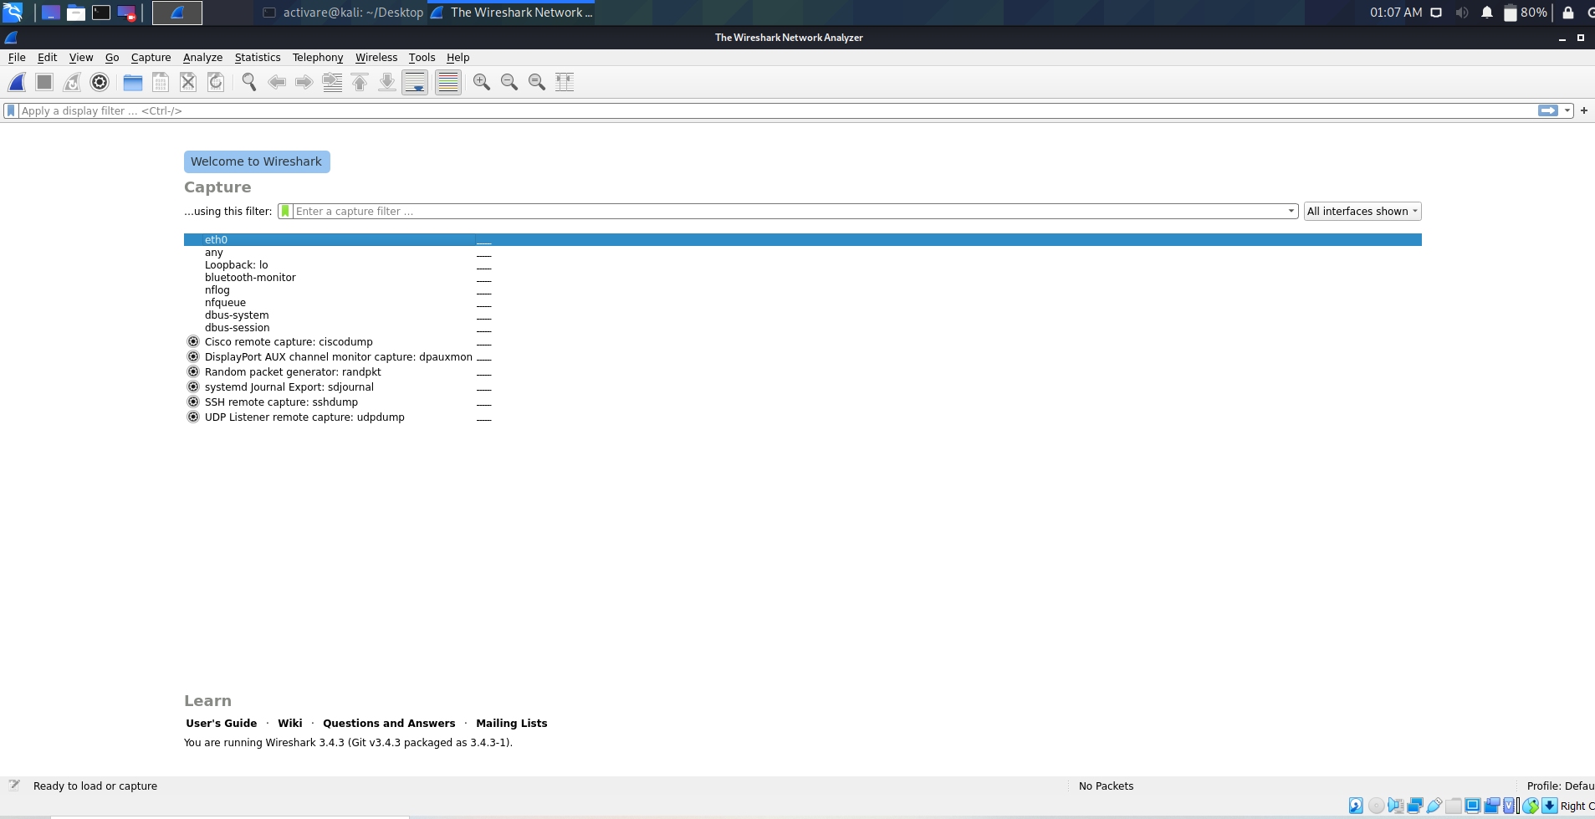
2. You can see the interface of the wireshark as shown in the image.

Slide 7
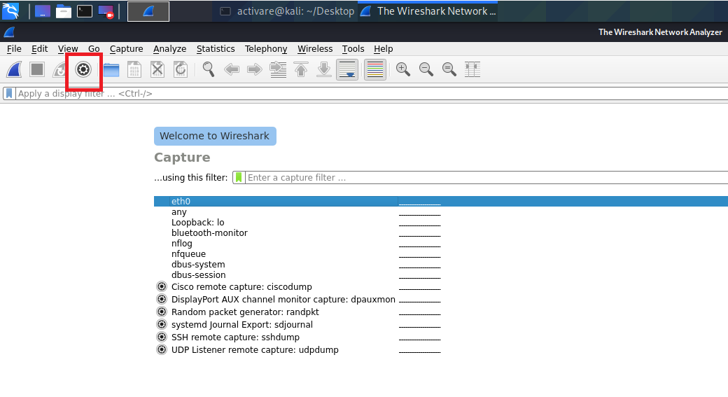
3. Click on Capture options as shown in the picture which is marked.

Slide 8
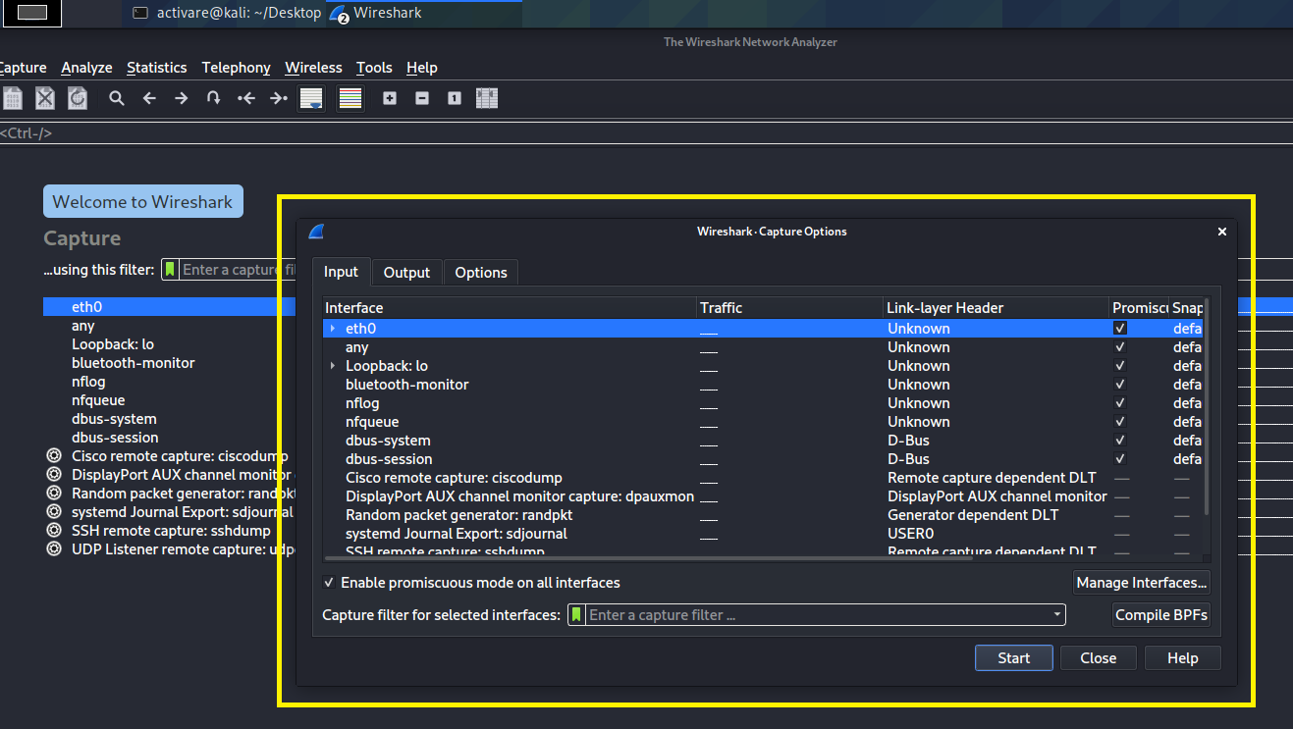
4. On Clicking Capture options a pop-out window will be appear as shown in the picture. And Now You can see all the interfaces of your network card in your system in the appeared pop-up windows as shown below.

Slide 9
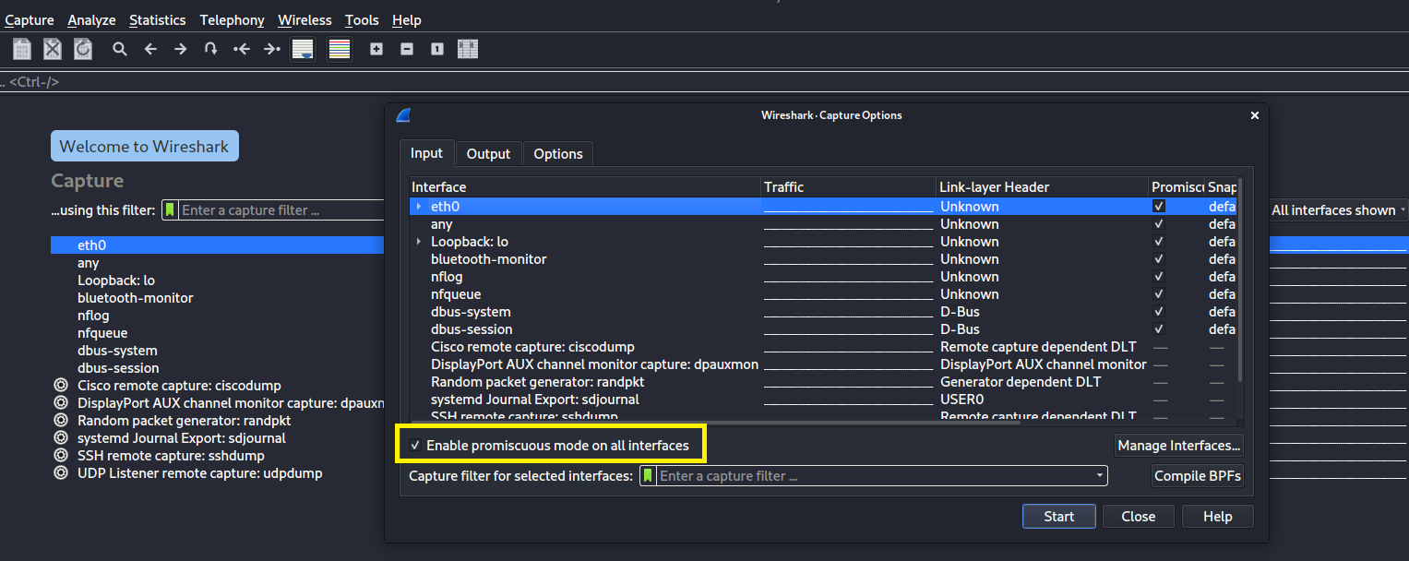
5. By default, Tick Mark will be applied on the “Enable Promiscuous mode on all interfaces”.

Slide 10
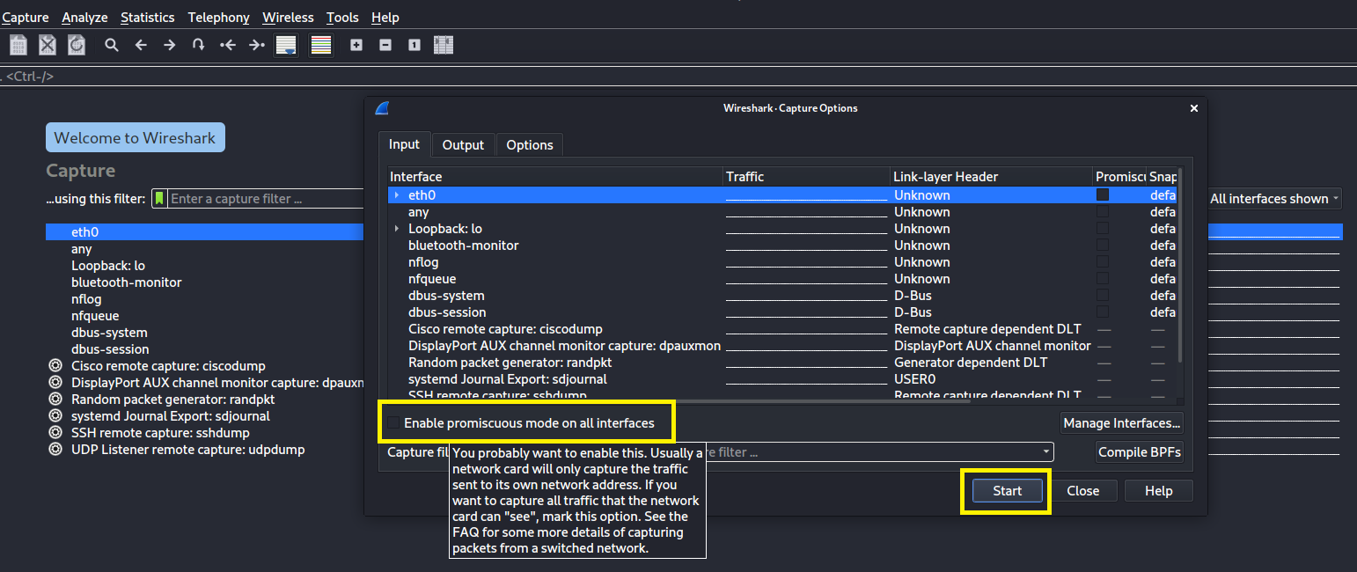
6. You just un-check the tick mark on it. Now Click on start button. From now on the Wireshark tool will capture the packets from your machine only.

Slide 11
2. For every network connection there will be a host which mean a sender and also a receiver. If you ever visit a website then a connection will be made from your device to servers of that host. So, Using Wireshark, find the destination computer’s IP address and also the MAC Address of the destination computer where the packet is delivered. Website: https://www.google.com/
Procedure: 1. Open terminal in Kali Linux, In Terminal type “sudo wireshark” then Wireshark will be opened. Now click on start capture as shown in the picture.

Slide 12
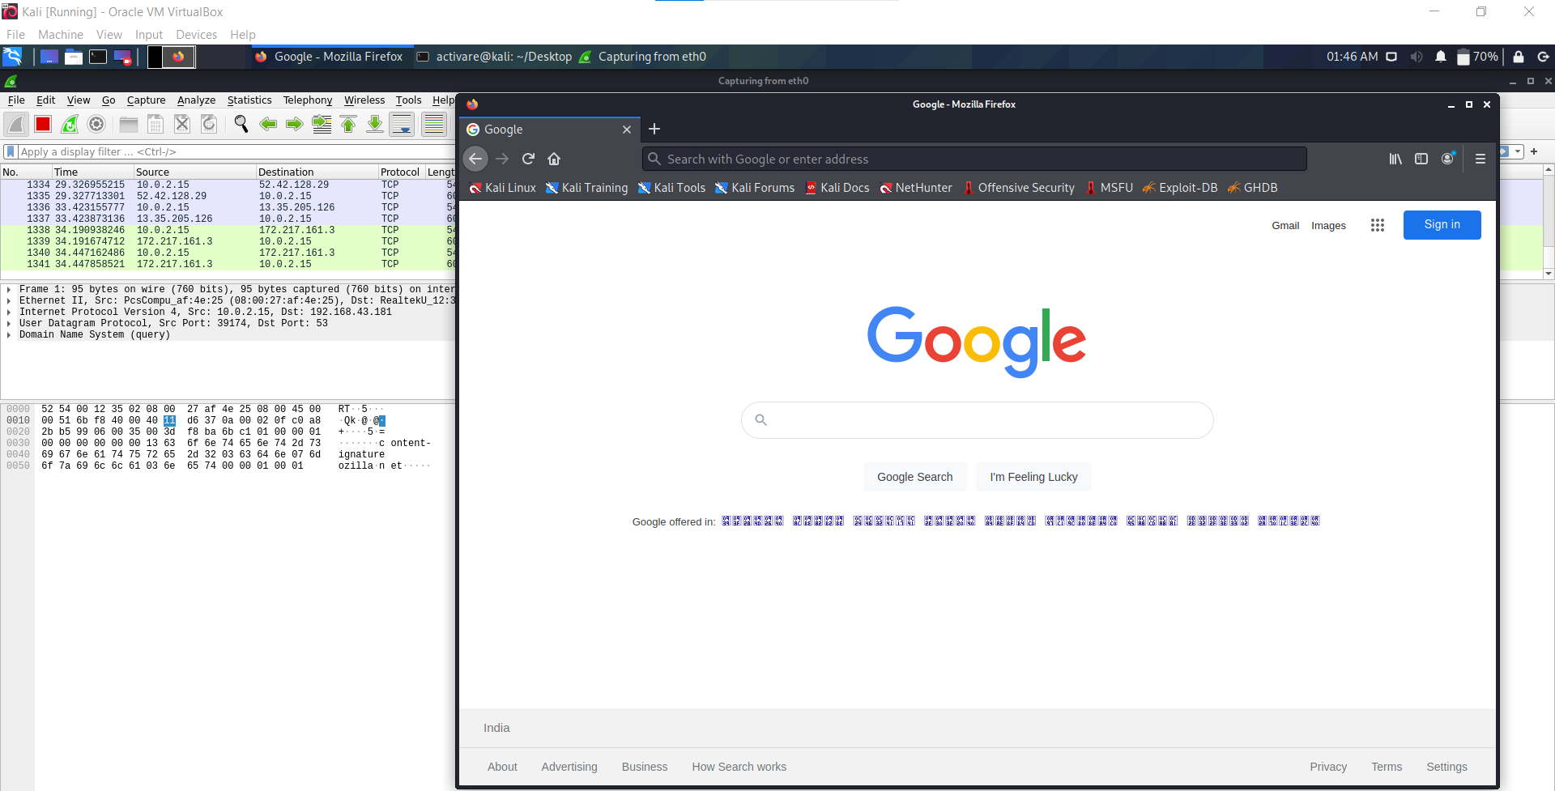
2. Now open a web browser and visit the provided website i.e., https://www.google.com/

Slide 13
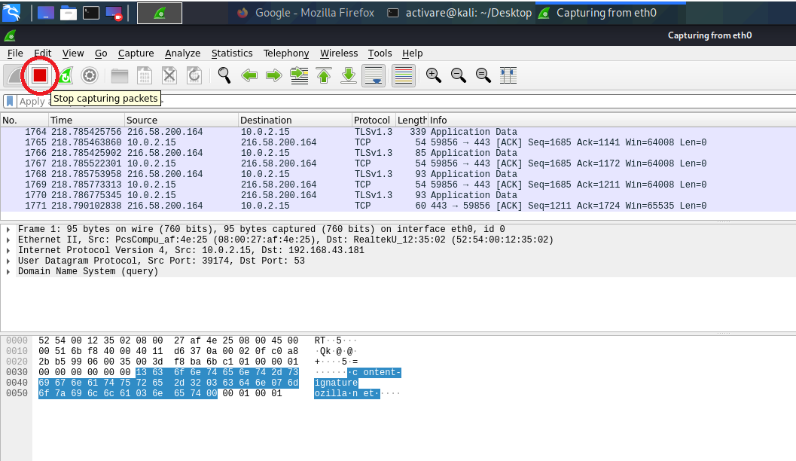
3. After visiting the website stop capturing the packets by clicking on red color button i.e., Stop Capturing Packets as shown in the picture.

Slide 14
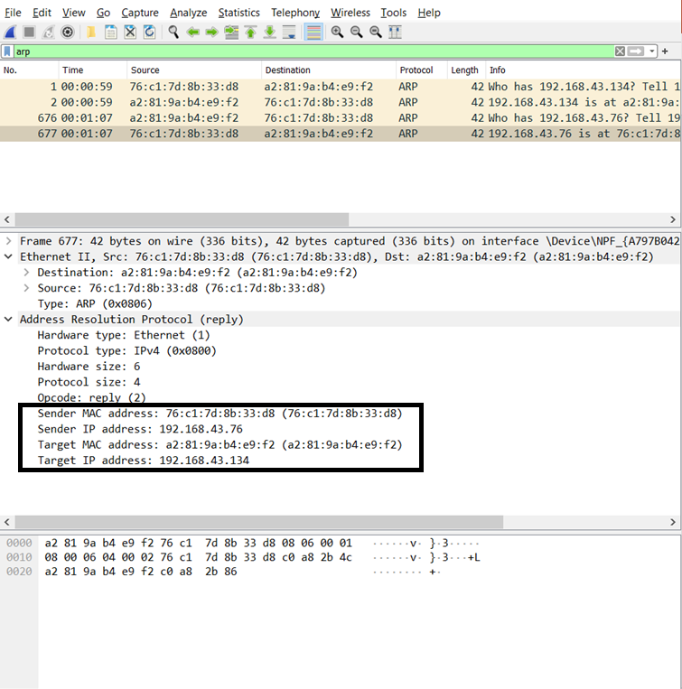
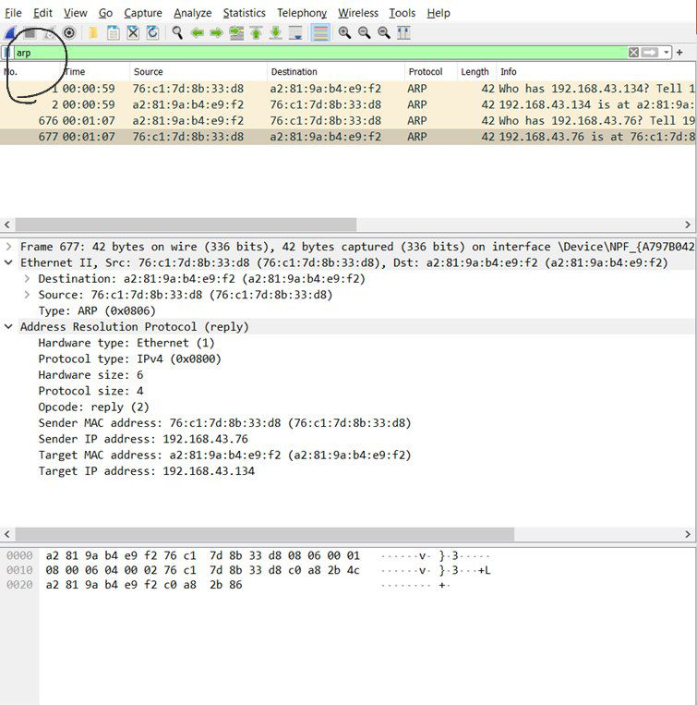
4. Now Type “arp” in filter where you can see the IP Address, MAC Address of the destination computer in packet details under Address Resolution Protocol (ARP) as shown in the picture.

Slide 15
3. In the above task you might have already captured the packet data. Among that packet data filter out the initial or the main packet. And now store the meta data like when the packet is captured, size of the packet and all other relevant information.
Procedure: 1. Open terminal in Kali Linux, In Terminal type “sudo wireshark” then Wireshark will be opened. Now click on start capture as shown in the picture.

Slide 16
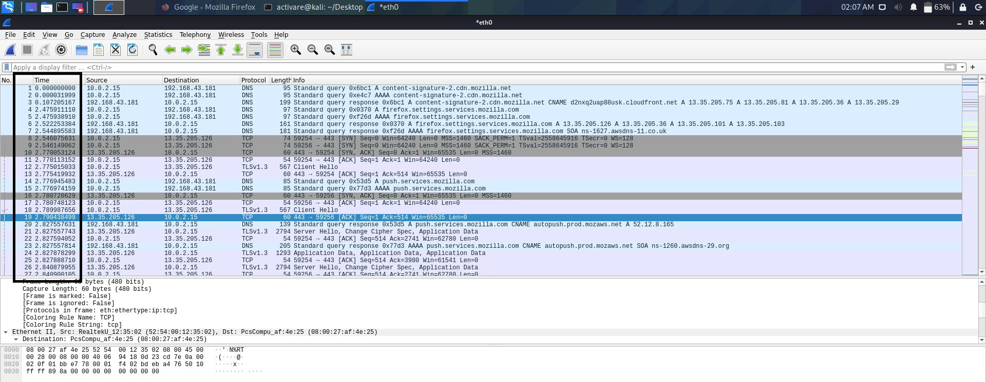
2. These are captured packets when we visit the site https://www.google.com/. And You can see the captured time of the packets are not human-readable.

Slide 17
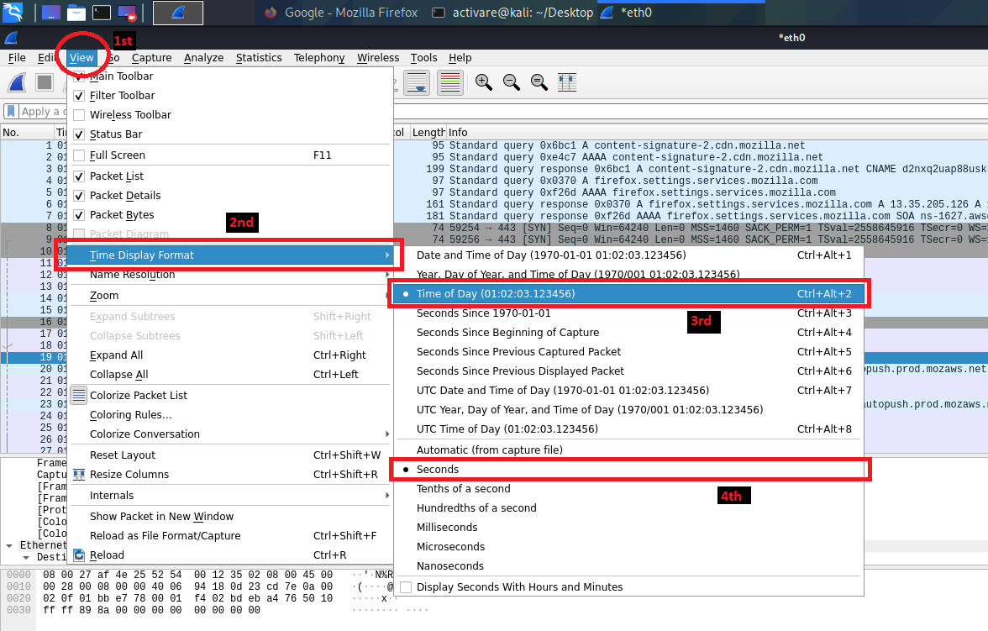
3. You can use filter to sort out the captured packets or may not!. Now click on the option “View”. In View, select Time Display Format -> First Select Time of Day and then select seconds as shown in the image.

Slide 18
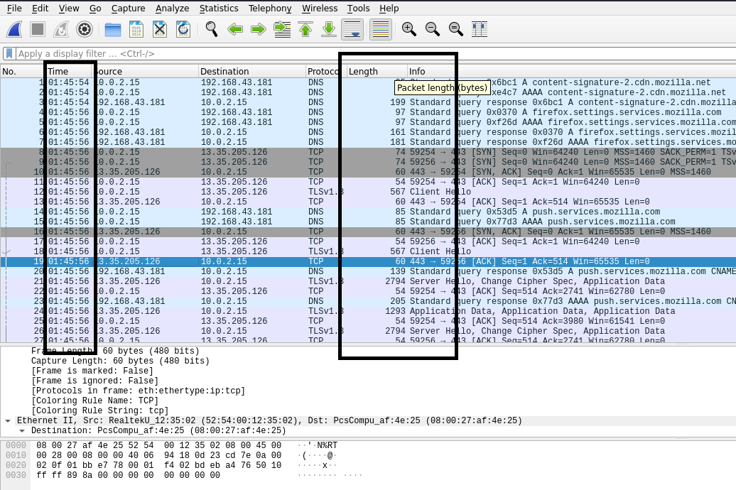
4. You could even see the packet size in bytes in the Length ”Column”. And when the packet is captured in general time (Human-readable Time Format) as shown in the image.

Slide 19
Post - Class Task

Slide 20
1. When you visit the above recommended websites a lot of traffic you can see. To do analysis it would be complicated work. So, Store the https and http packets separately using the Wireshark tool and also identify or fetch the post data when you perform a login activity in the http website.
Procedure:
1. Open terminal in Kali Linux, In Terminal type “sudo wireshark” then Wireshark will be opened. Now click on start capture as shown in the picture.

Slide 21
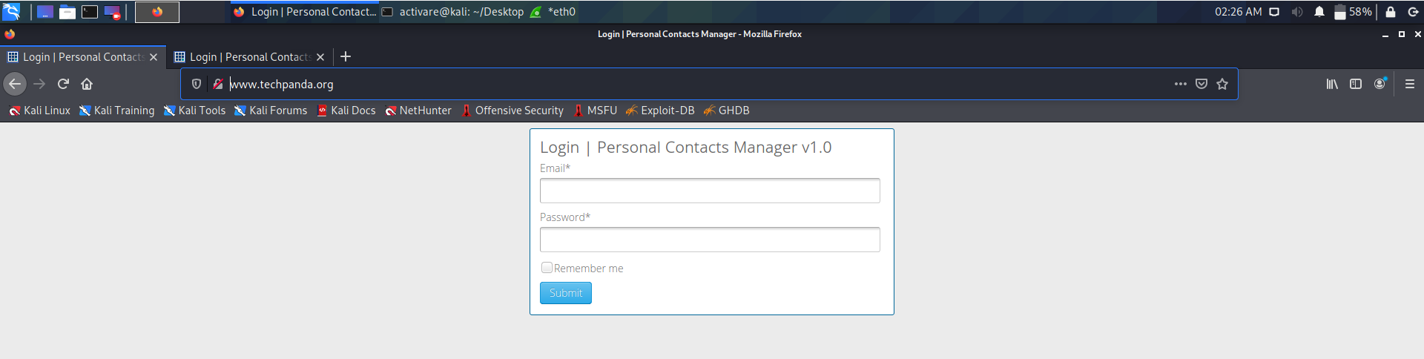
2. Now visit the http server website i.e., http://www.techpanda.org/ in the browser as shown in the picture.

Slide 22
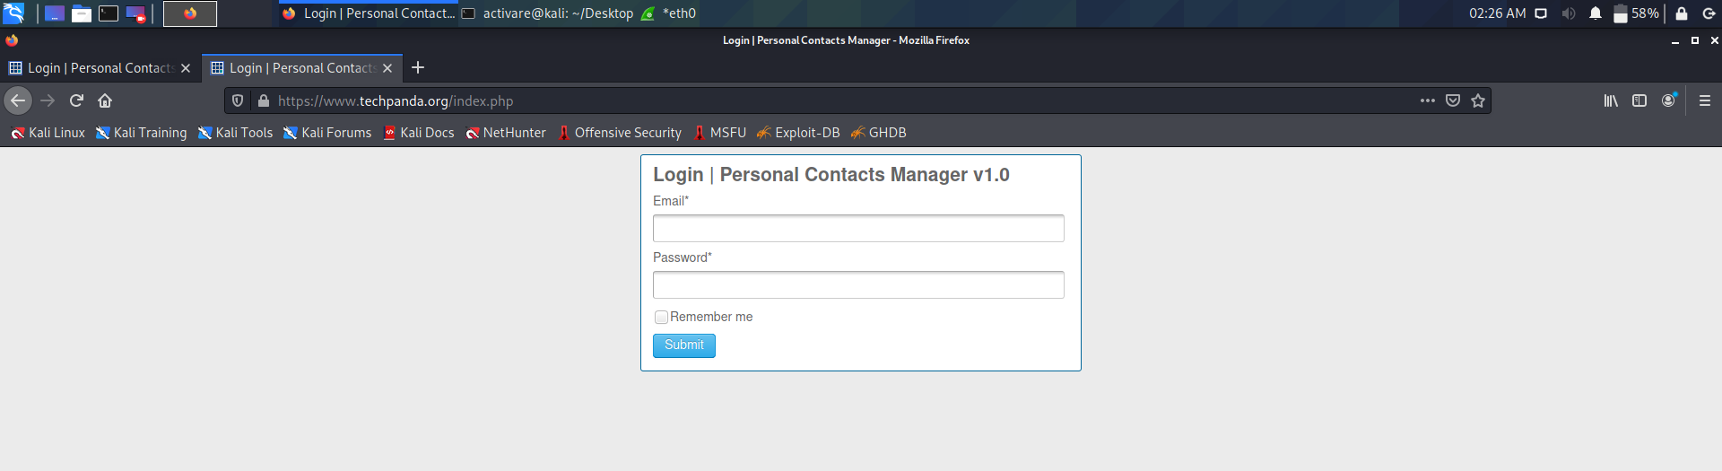
3. Now visit the https server website i.e., https://www.techpanda.org/index.php in the browser as shown in the picture.

Slide 23
4. After visiting the website stop capturing the packets by clicking on red color button i.e., Stop Capturing Packets as shown in the picture.

Slide 24
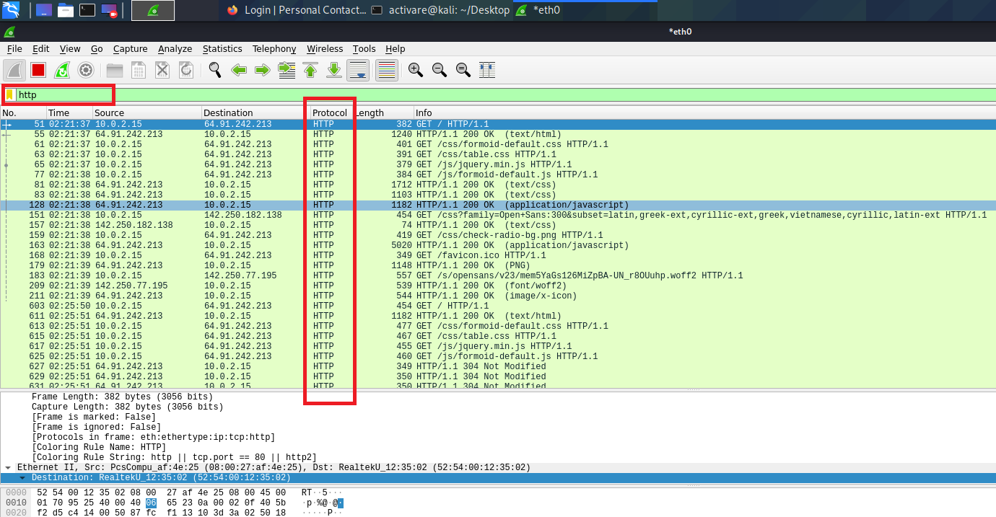
5. Type “http” in the filter then you can see only http server packets as you can now it displays only the http protocol packets.

Slide 25
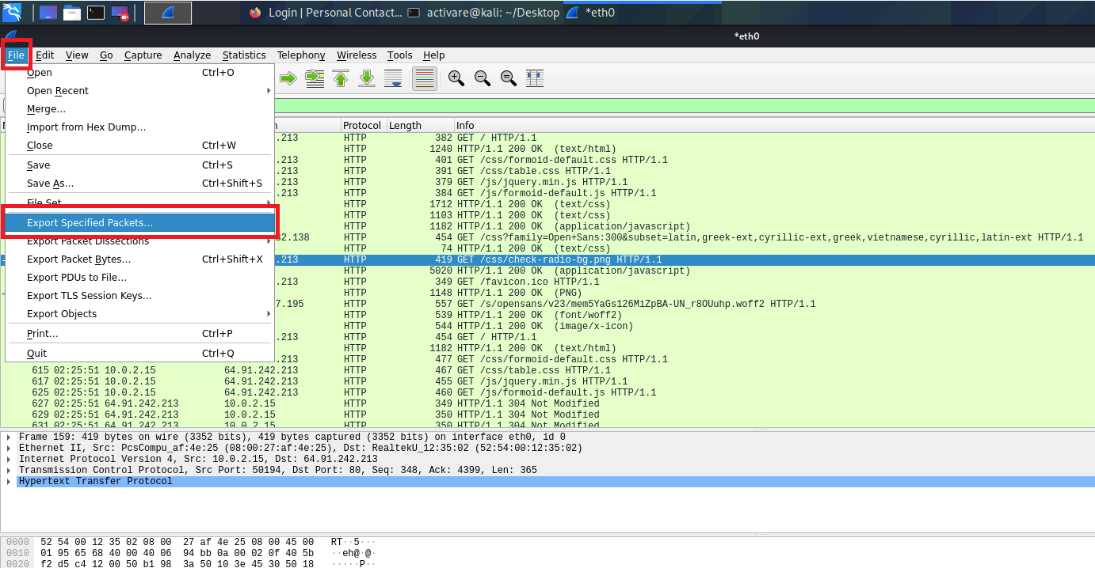
6. Click on the “File”. In File, Click on the “Export Specified Packets” as shown in the image.

Slide 26
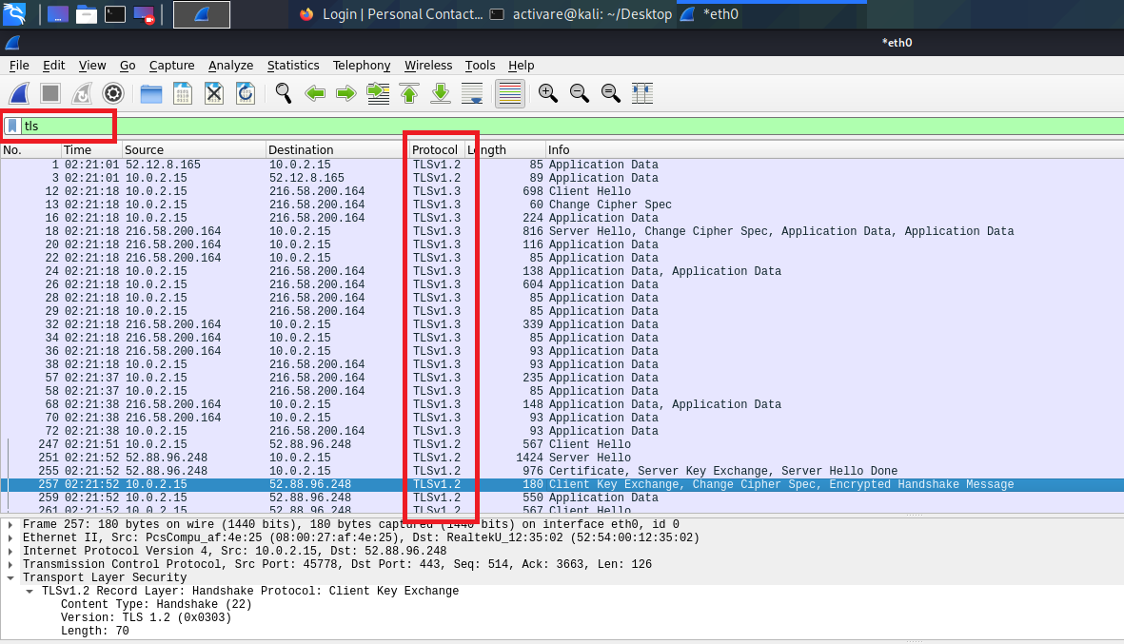
7. Type “tls” in the filter then you can see https packets and also tls packets.

Slide 27
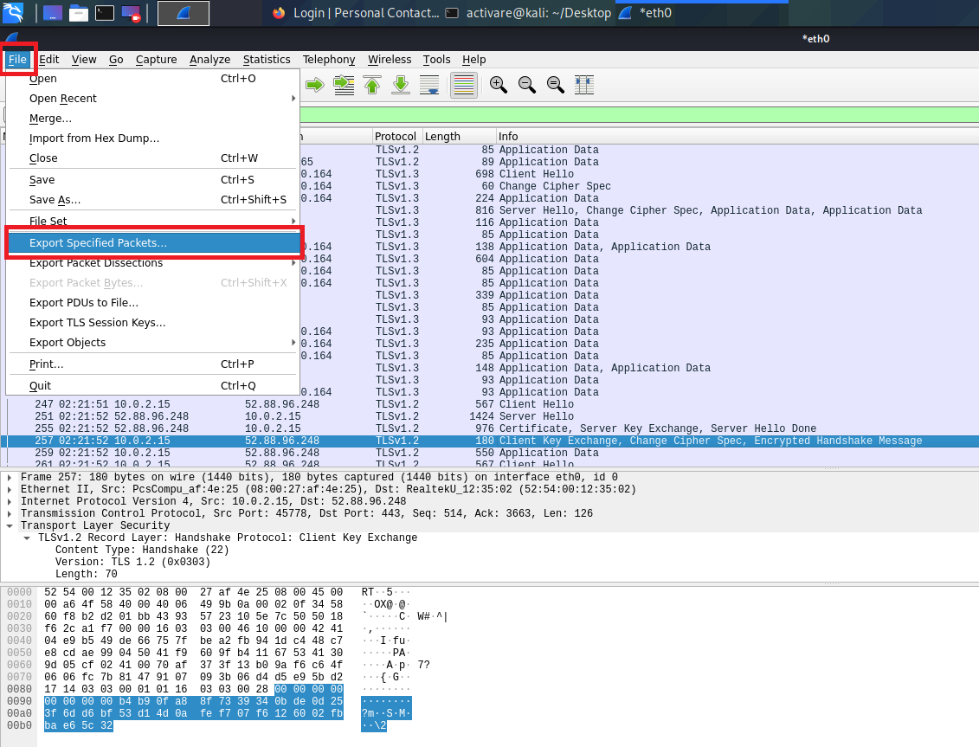
8. Click on the “File”. In File, Click on the “Export Specified Packets” as shown in the image.

Slide 28
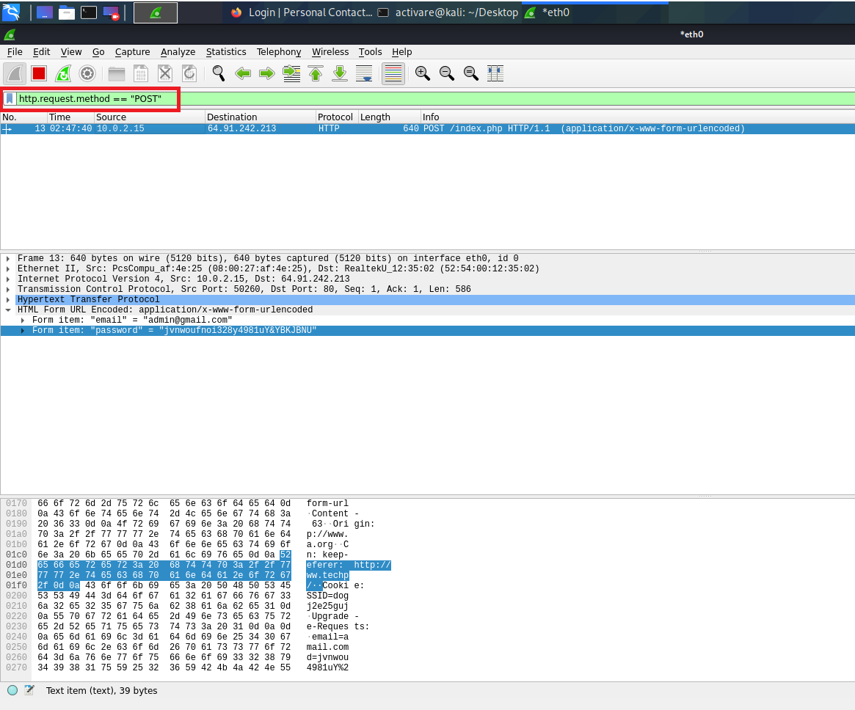
9. In filter type “ http.request.method == “POST” ” to filter out the http post data to the server from the client side.

Slide 29
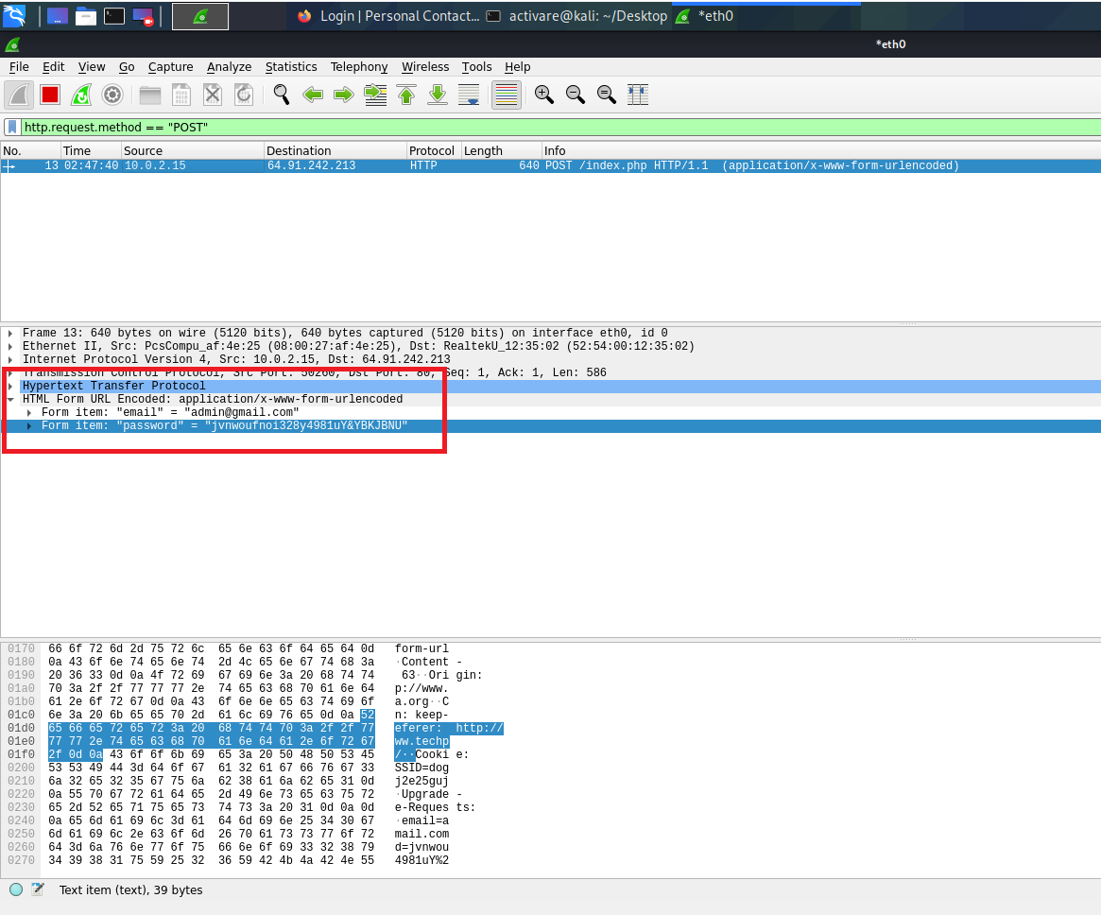
10. Select the Post Packet. In Packet details section, Click on the HTML Form URL Encoded: application/x-www-form-urlencoded where you can see Post Data i.e., Email and Password as plain text. As shown in the image.

Slide 30
2. Visit the site https://www.google.com/ . On visiting the site as usually can observe different kind of packets. And a connection is also established between client system and host (servers). Using Wireshark, capture the network packets of a virtual port (Port 443).
Procedure: 1. Open terminal in Kali Linux, In Terminal type “sudo wireshark” then Wireshark will be opened. Now click on start capture as shown in the picture.

Slide 31
2. Now open a web browser and visit the provided website i.e., https://www.google.com/

Slide 32
3. After visiting the website stop capturing the packets by clicking on red color button i.e., Stop Capturing Packets as shown in the picture.

Slide 33
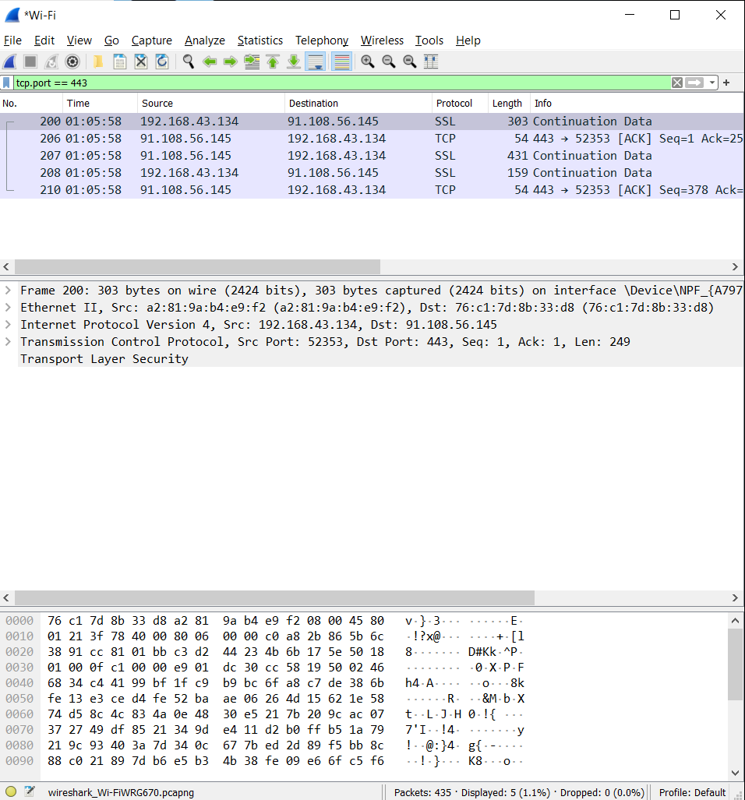
4. In filter type “tcp.port == 443” It is virtual port. Where it will display the packets in tcp of port is 443 which is a virtual port as shown in the image.

